Slide 1
BT Project Management Framework
BT Business Case Template Updates

Slide 2
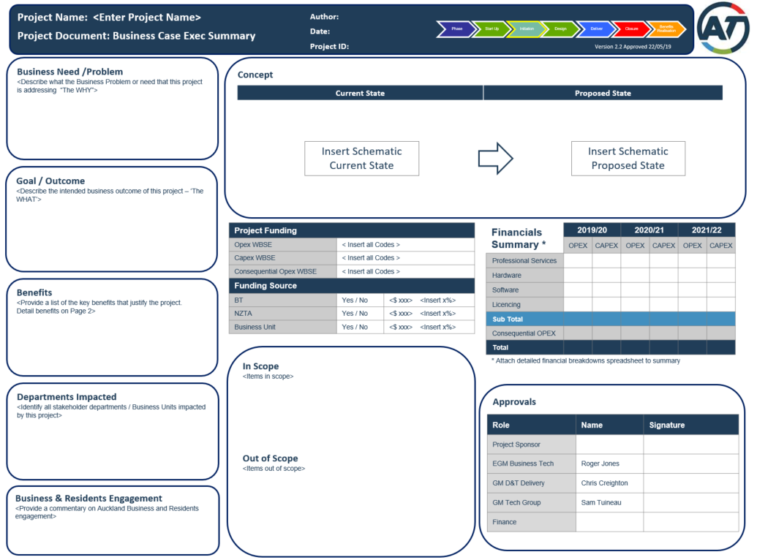
BT Business Case Template – Updates to Page 1
1
Project funding table
Now on Page 1, was previously on page 2
2
Business & Residents Engagement
This new section has been added to all AT Business Case templates on request from Shane Ellison
1
3
Approvals
Roger Jones has been added as a signatory, due to recent DFA changes
3
2

Slide 3
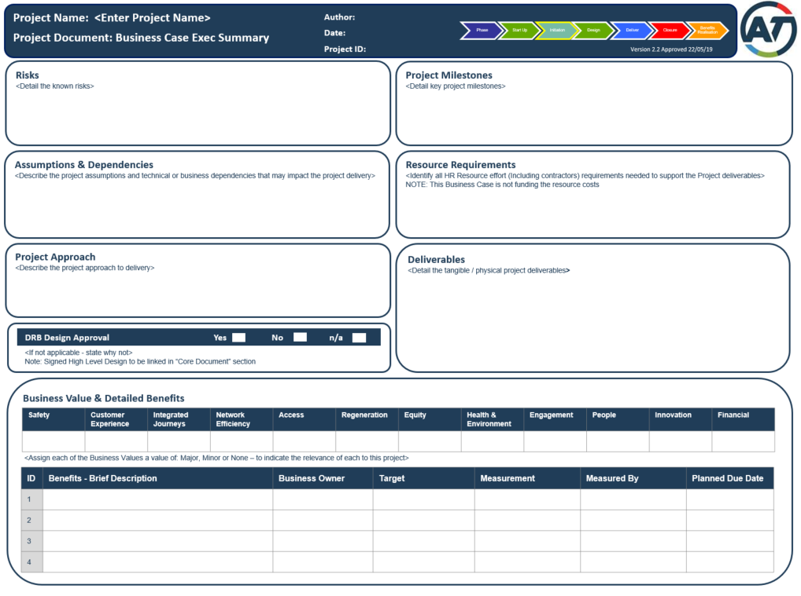
BT Business Case Template – Updates to Page 2
4
Resourcing Requirements
Now on Page 2, was previously on Page 1
5
4
DRB Design Approval
Now on Page 2, was previously on Page 1
6
5
Business Value Measures
New section added on request from Roger Jones. Each Business Value measure needs to be assigned a value of Major, Monor or None in line with the BT Capital Planning process followed for FY19/20.
Cheat sheet for these 12 values is included in Appendix 1
6

Slide 4
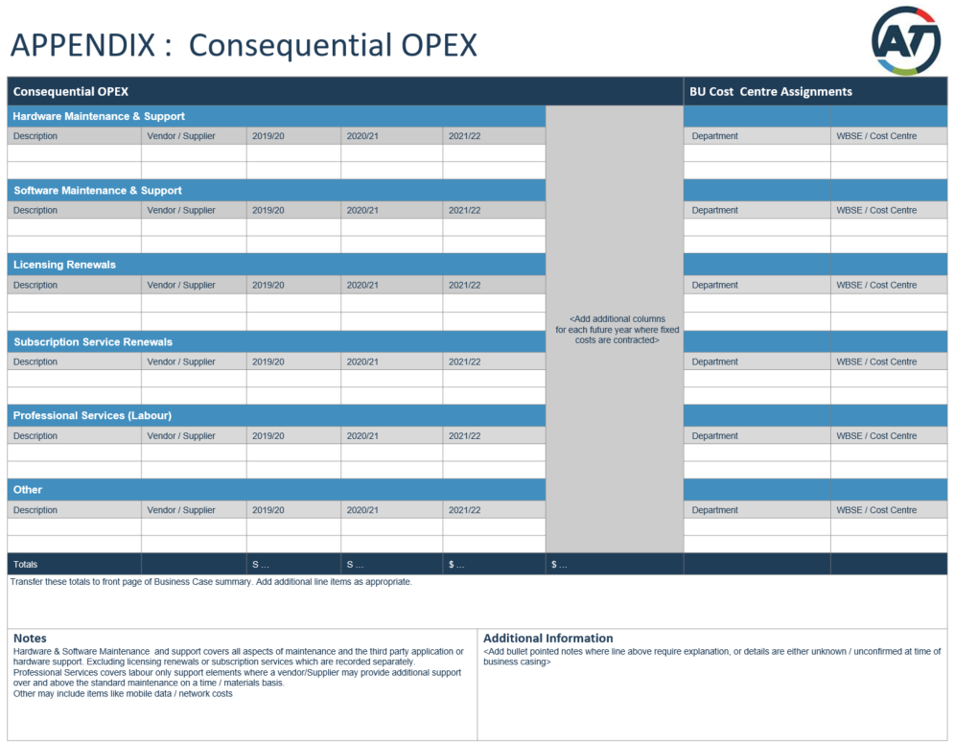
BT Business Case Template – Updates to Page 3
7
7
Consequential Opex
Dates have been updated to be current and reflect the new Financial Year

Slide 5
BT Project Management Framework
Appendix 1: Business Value Cheat Sheets

Slide 6
Appendix 1 – Business Value Cheat Sheet (1 of 3)
8 x External Performance Goals:
1. Safety - Prioritise safety for all
The safety and wellbeing both physical and mental of our staff, suppliers, contractors and the general public is of upmost importance and is the priority in everything that we do. | Our goal: Our long term goal is Zero Harm for those who use or work in our network, interact with our assets, are affected by the actions of our delivery partners or carry out activities on our behalf, such as construction. Whether this be through land, maritime, or public transport operations, health and safety is at the forefront of everything we do.
2. Customer Experience - Deliver a positive customer experience through all interactions
There are millions of interactions with AT and our partners everyday both face to face and through digital channels. Each is an opportunity to deliver a positive, meaningful and satisfactory experience to our customers that can brighten and improve their day. | Our goal: To deliver an excellent experience, regardless of the reason for interaction. Understanding the customer experience is an integral part of customer relationship management.
3. Integrated Journeys - Enhance our customers’ daily journey as they move around Auckland
Our customers spend a significant proportion of their lives using the assets and services we provide, often without a realistic alternative option. Ensuring we continue to deliver against the standards we set and that our customers expect, is key. | Our goal: For our customers to experience journeys that are safe, reliable, resilient and connected, across public transport, active modes and road users.
4. Network Efficiency - Create an efficient transport system
The movement of people, goods and services to and around Auckland drives productivity and ultimately the prosperity of our people. Congestion currently imposes costs estimated to be worth $1.3bn a year, preventing further deterioration in the face of an increasing population will be a defining challenge. | Our goal: Optimising the use of the existing network to get the most productive use from our assets and resources in terms of capacity, utilisation, throughput, and ultimately the movement of people throughout the city.
* Note: The content on this slide has been taken from the AT Performance Management Framework (v9.1) draft – which is still to be finalised

Slide 7
Appendix 1 – Business Value Cheat Sheet (2 of 3)
8 x External Performance Goals, continued:
5. Access - Ensure access to opportunities improves as Auckland grows
The movement of people, goods and services to and around Auckland drives productivity and ultimately the prosperity of our people. Congestion currently imposes costs estimated to be worth $1.3bn a year, preventing further deterioration in the face of an increasing population will be a defining challenge. | Our goal: We realise the benefits of Auckland’s growth through increasing accessibility by all modes to employment and services, schools, leisure centres and other key Auckland destinations.
6. Regeneration - Use transport investment to support a quality compact city
Investment in transport shapes the city we live in. Our interchanges are some of the busiest places in New Zealand and catalyse the development of new housing, businesses and offices | Our goal: To provide a transport system that improves Auckland’s liveability, supports growth, urban redevelopment and regeneration, and promotes access to employment and places that are convenient and suit our lifestyles.
7. Equity - Make the transport network accessible to all
Access to education, health services and employment is an important determinant of success. Providing equal access gives opportunities to those that may otherwise miss out due to physical disadvantage or geographical separation. | Our goal: A transport network that provides everyone, particularly those that are disadvantaged, with an equal opportunity to access all Auckland has to offer – including economic, social and cultural activities.
8. Health & Environment - Reduce the impact of transport on the environment & human health
Encouraging use of active modes improves our health and reduces the emissions that would otherwise have been generated, while mitigating the impacts of infrastructure and services on the environment will ensure our environment can be enjoyed by us and future generations. | Our goal: To reduce the impact that we and those who use our assets have on the environment and human health through our investments and services.
* Note: The content on this slide has been taken from the AT Performance Management Framework (v9.1) draft – which is still to be finalised

Slide 8
Appendix 1 – Business Value Cheat Sheet (3 of 3)
4 x Internal Performance Goals:
9. Engagement - Improve the effectiveness of our community engagement
Engaging with our customers provides us with a much better understanding of the problems they face and how the solutions we propose and whether the benefits and costs provide value for money, allowing us to optimise decisions and demonstrate the collaborative perception we aspire to. | Our goal: Creating better relationships with our stakeholders and helping our customers to participate in consultation.
10. People - Enhance the experience of our people to deliver AT’s strategic goals
Without a healthy, engaged and appropriately skilled workforce we cannot hope to deliver the ambitious plans we have in place over the next 10 years. Ensuring that we are all in a position to best deliver for Auckland is paramount. | Our goal: Enhance organisational effectiveness to ensure AT delivers on its strategic goals, by developing a culture of leadership, wellbeing and learning, where everybody has the capability and opportunity to grow and perform at their best. An inclusive workplace where our people feel safe, respected, valued and supported, regardless of our differences.
11. Innovation - Continue to improve our organisation through innovation
Technology is changing the world at a rapid pace along with the demands of our customers and the ways they will interact with transport. Taking advantage of the latest innovations is the only way we can keep pace with change and be the world’s most liveable city. | Our goal: To lead the NZ public and private sector by bringing new and improved methods, practises, products, people, services or technology that add value or improved outcomes to our customers through innovation. Innovation is intrinsic to all of AT’s external performance goals.
12. Financial - Ensure our organisation meets financial performance targets
Financial pressures are increasing as many of our older assets begin to be replaced and the need to do more with less is impressed upon us by our funders. Being commercially aware and providing value for money through our investment decisions will be a key attribute we will all need to exhibit. | Our goal: Value for money across all of our investments through the balance of costs against all forms of benefits from those that are cashable to social and environmental benefits.
* Note: The content on this slide has been taken from the AT Performance Management Framework (v9.1) draft – which is still to be finalised

